Slide 1
Milestone: Update
Kaitlyn Moten, Anthony Mercer, Shannon Richardson, Phillip Phuong

Slide 2
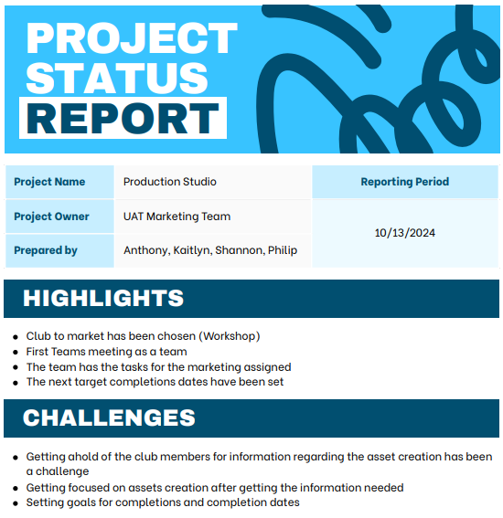
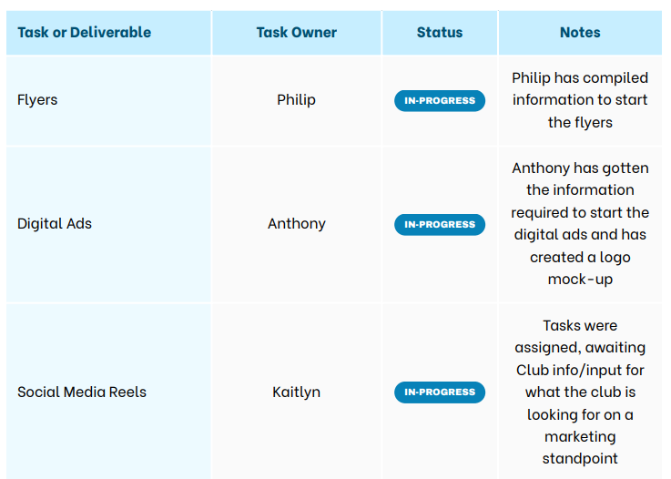

Slide 3
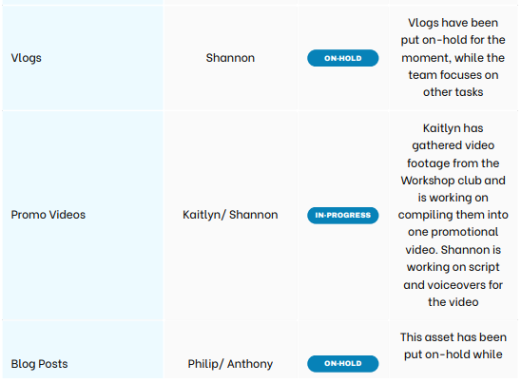
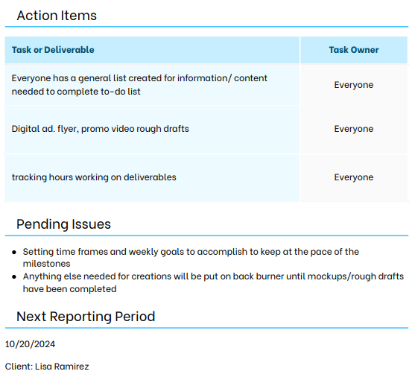
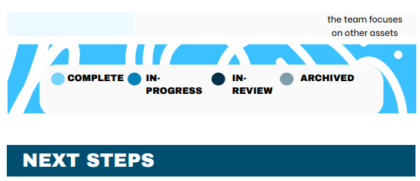

Slide 4
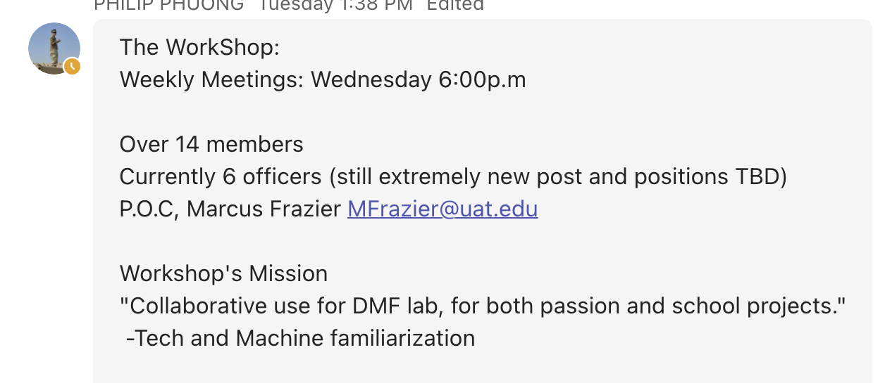
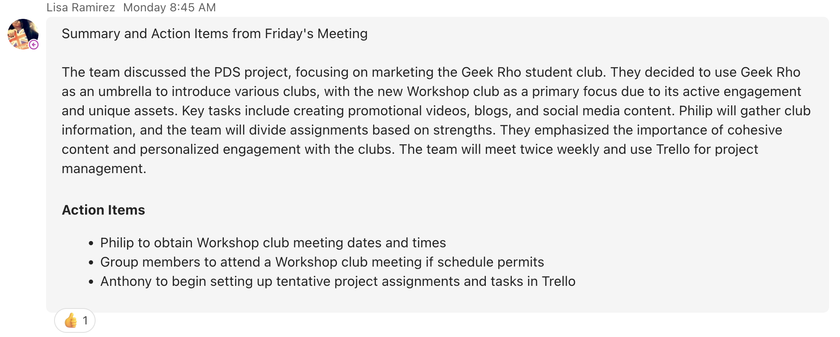
The on-campus part of the team has been working/meeting with the club to gather and retrieve as much information that is needed to complete our assets. With the last couple meetings, we have retrieved the information needed to start our mockup & digital creations.

Slide 5
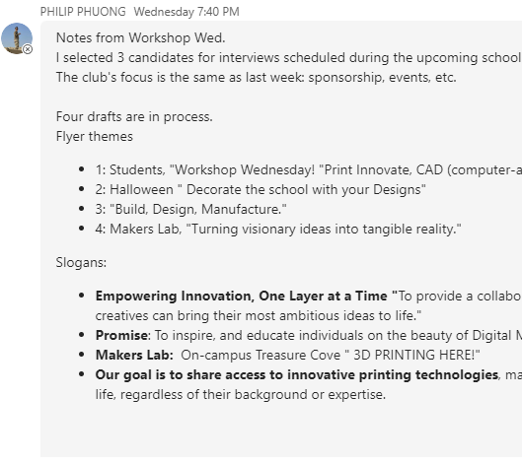
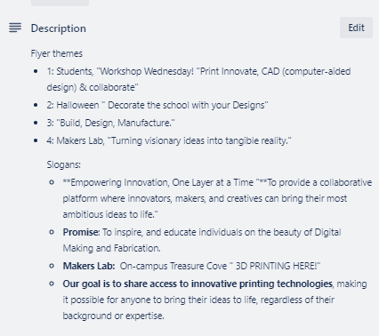
With the information Philip has gathered and surveyed the club to get his ideas on what the completed flyers are going to contain and the information they are going to hold!

Slide 6
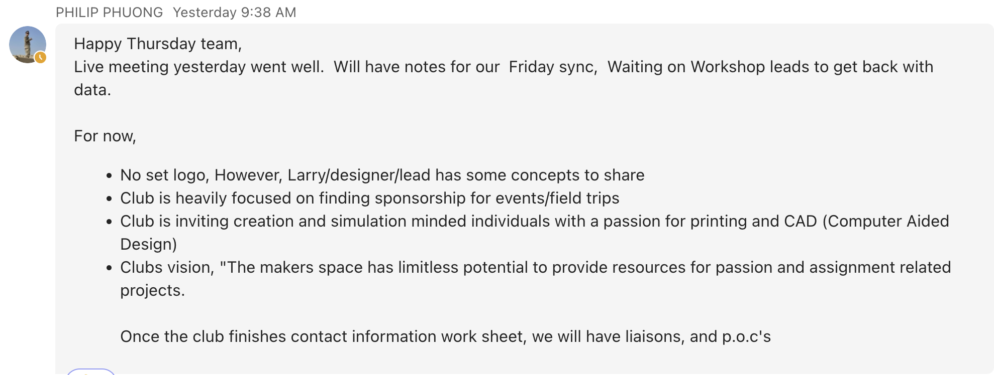
ORIGINAL
REFORMED/REVAMPED
Anthony created a mockup of what the club's logo could look like with some touch-ups and color remodeling.

Slide 7
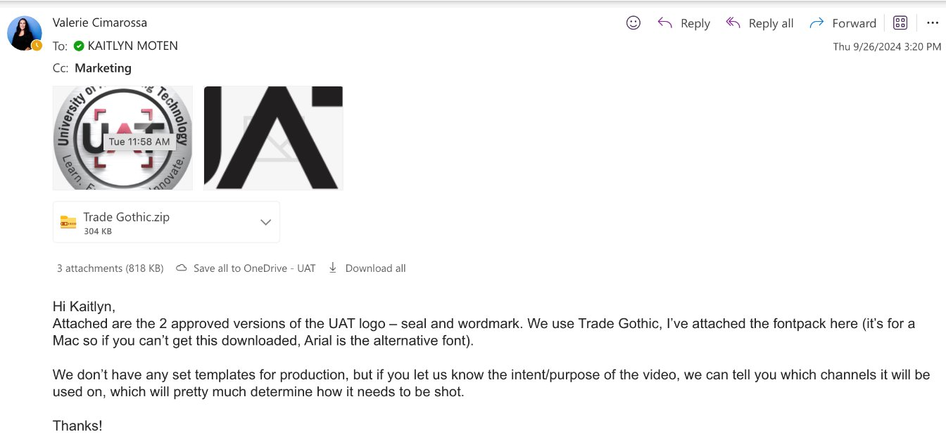
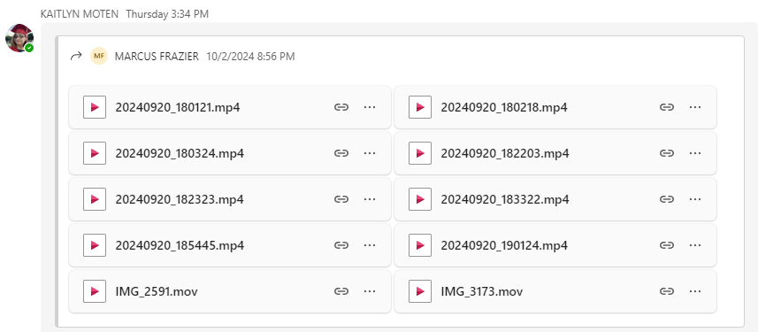
Kaitlyn received the UAT logo and video footage needed to start/create the promo video! Adding a leg in the race towards completion and setting us on-time and on-track.

Slide 8
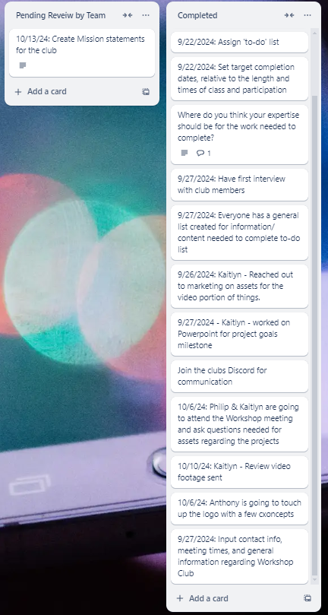
The team has completed a lot along the way and now that we have completed what we need to get things onto the next step, we are beginning to roll out the assignments for the next step with the goals and target completion dates. We can say we are on-target and will have our assets for the club rolling out on a timely manner each week. This goes along with current and up to date information on where we are and when things can be expected!

Slide 9
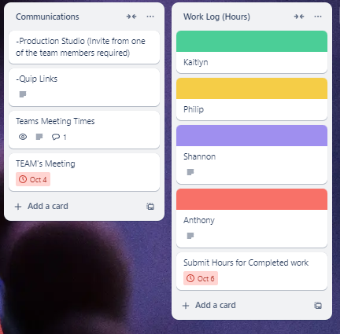
Our team is meeting weekly to stay on task and review completions and keep each other on task and up to date on what is going on within the one another's tasks and if anything is holding us back from reaching the goals we are setting.

Slide 10
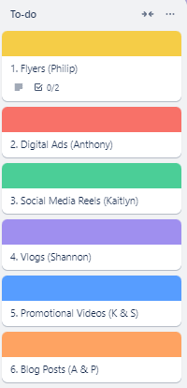
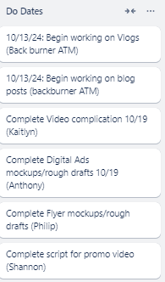
Upcoming projects
The team has their goals set for this week and the week to come on asset creations, what is expected of everyone, and the target completion dates for the next milestone, 10/20/2024.
Kaitlyn – Video editing (information assets gathered): Starting on October 14th
Shannon – Script and Voiceover for the video creations, Script writing starting October 14th
Phillip – Flyers (information gathered) digital creation beginning October 14th
Anthony – Digital Ads (Digital assets gathered) starting October 14th

Slide 11
Discord: https://discord.gg/YgfK35Mm
Main Contact: Larry
Club Meetings: Wednesday @3:00PM
Club Contact info:

